Slide 1
Circuit Verification
CS386 Assignment: Group 12
Sahil Jindal Abhishek Gupta Rohan Gyani Mridul Ravi Jain
110020043 110040067 110040001 110040083

Slide 2
Assignment Specifications
A circuit is defined by its input, output, gates and connectivity.
There is circuit specific knowledge and circuit independent knowledge.
Circuit independent knowledge is properties of gates (AND, OR, NOT etc) and the meaning of connectivity. You should read all this knowledge into the PROLOG memory.
However, keep the circuit independent knowledge memory resident.
The final goal is to verify the input and output in each row of the truth table

Slide 3
Rules Defined
type(X, a).
a: 'AND', 'OR', 'NOT','XOR'
Represents type of gate X
no_of_inputs(X, val).
val : 1, 2, ....
Gate X has val inputs
count_1s(X , num_inputs, val, acc).
Counts number of 1s as input to gate X
num_inputs: input index to gate X
acc: accumulator variable(initialised to zero)
val: final result is stored in this variable
signal(x_{n},a).
Signal at x_{n} is a (x_{n} is input to circuit)

Slide 4
Rules Defined
in(n,X, val).
n^{th} input to gate ‘X’ is ‘val’
in(n,X).
n^{th} input to gate ‘X’
connected(x1, x2).
Used to specify connections in the circuit
Eg: connected(x1,in(1,a1))
x1 is connected to 1st input of gate a1
out(X,Val).
Output of gate ‘X’ is stored in ‘Val’
out(X).
Output of gate ‘X’

Slide 5
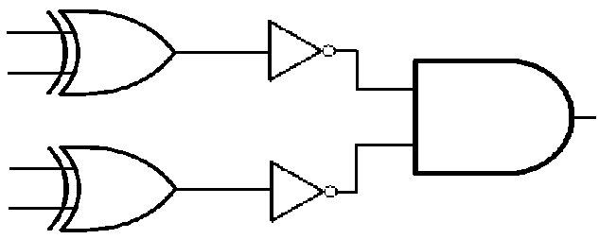
5-input Palindrome Circuit
x₀
x₄
x₂
x₃
x₁
Output= ( x₀ x₄ ) . ( x₁ x₃ )
+
+

Slide 6
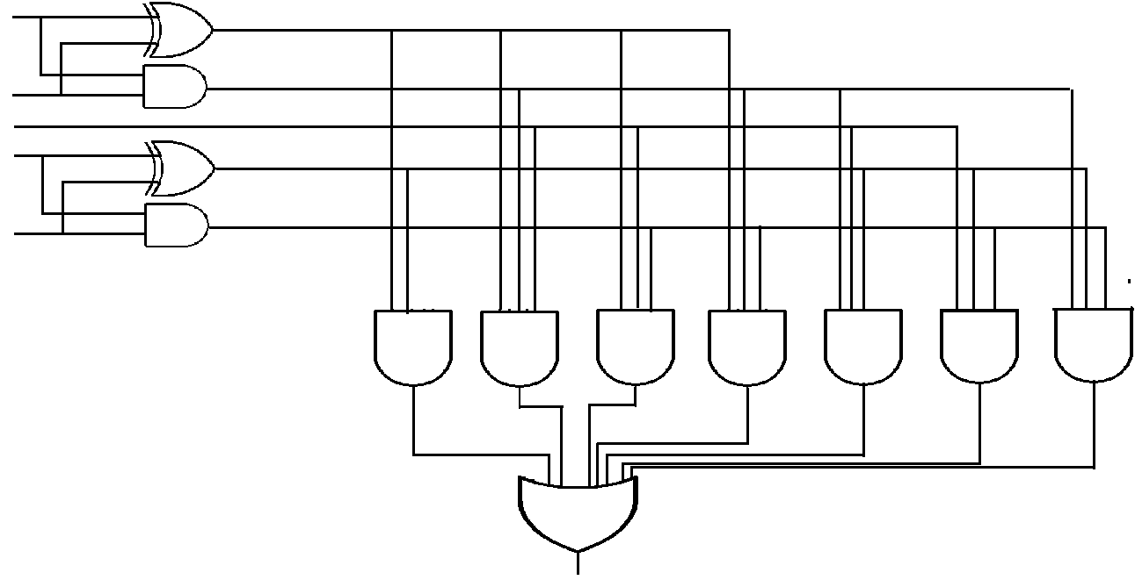
5-input Weighted Majority Circuit
X₄
X₃
X₂
X₁
X₀

